Slide 1
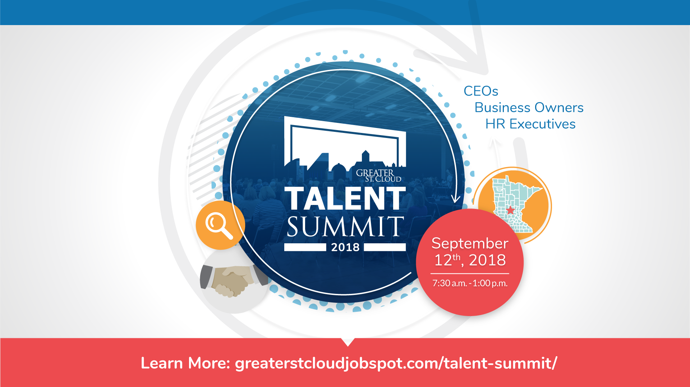

Slide 2

Ignite Your Talent Strategy
PRESENTED BY
Joan Schatz and Kelly Hansen

Slide 3
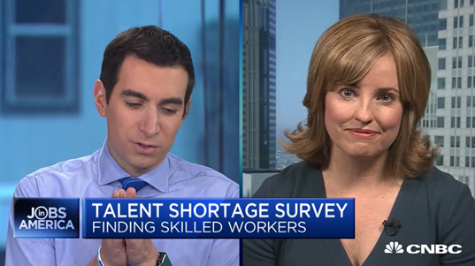
July 2018, Becky Frankiewicz, Manpower Group North America President
Notes:
3:50

Slide 4

Talent Vision
Park’s Journey
Our Why
Strategic Vision
Business Partner

Slide 5
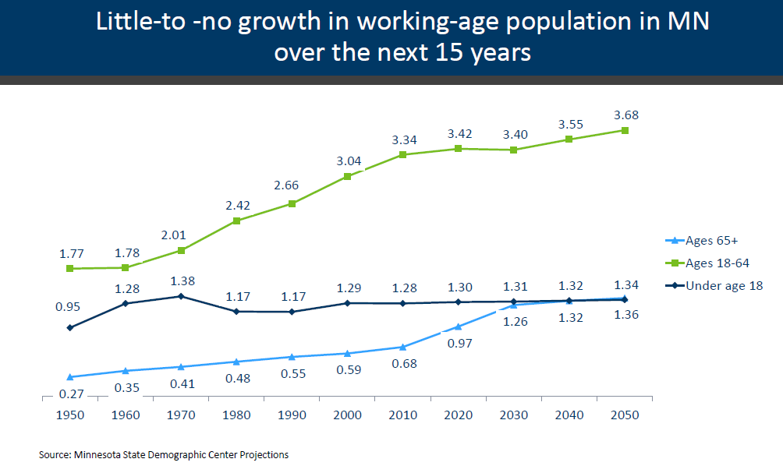
Buzz about Talent Strategy

Slide 6
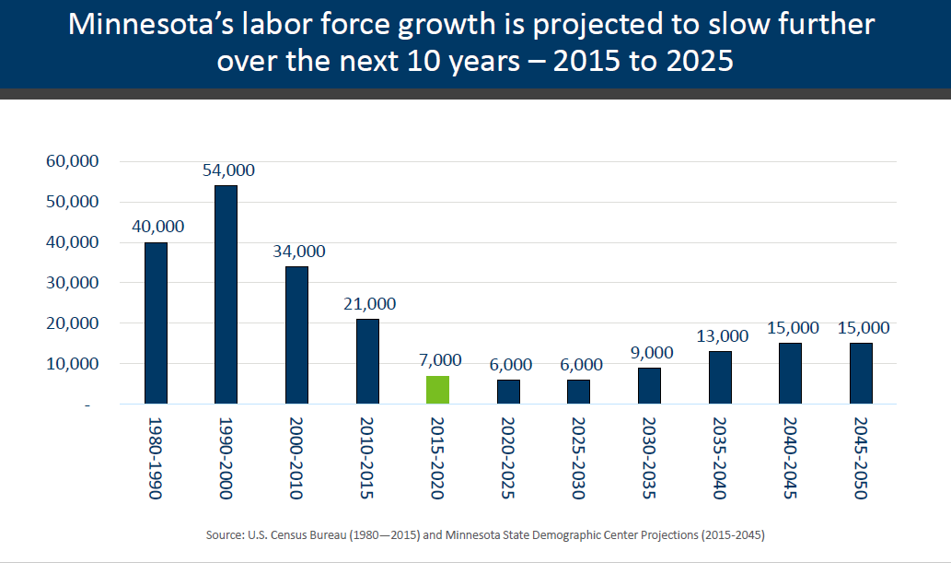
Buzz about Talent Strategy

Slide 7
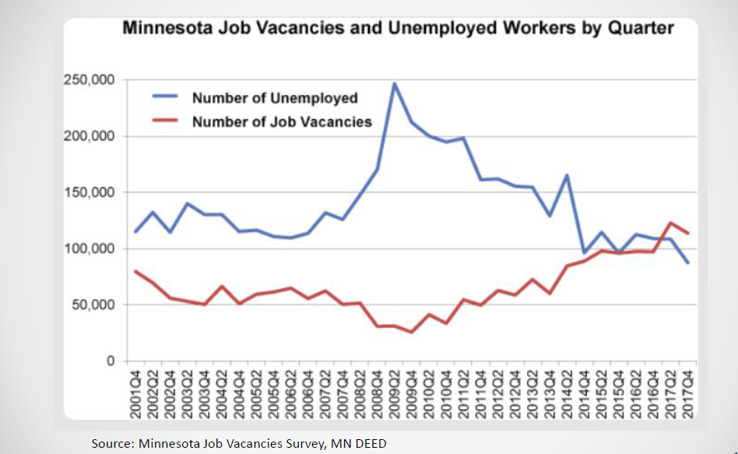
Buzz about Talent Strategy

Slide 8
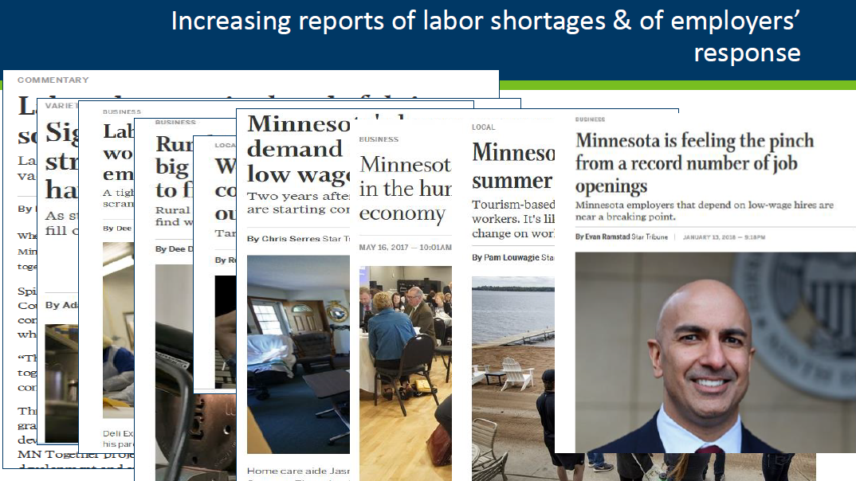
Buzz about Talent Strategy

Slide 9
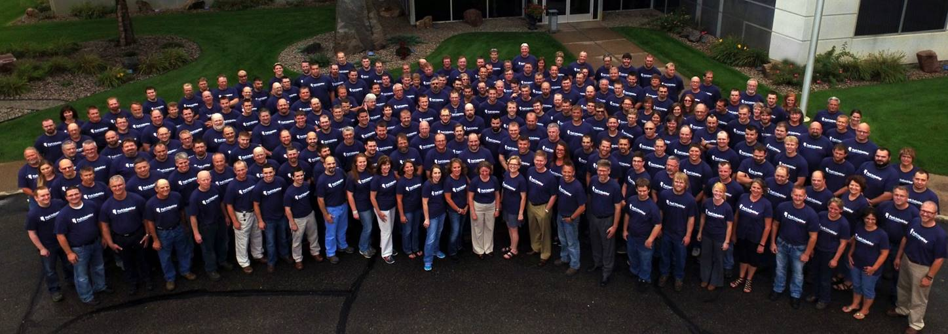
Company Vision, Purpose, and Strategy
Talent Strategy
Leadership
Culture

Slide 10
Talent Strategy Model
Talent Strategy
Total Rewards
Employment Branding
Sourcing & Recruiting
Selection & Assessment
Orientation & Onboarding
Positions & Career Paths
Goal Alignment & Metrics
Succession & Talent Review
Performance Management
Training & Development
HiPo ID & Leadership Development
Engagement
Retention
Talent Priorities
Strategic Imperatives
Core Organizational Capabilities
Strategic Workforce Plan & Talent Segmentation

Slide 11
Talent Lifecycle
Acquire
Deploy
Brand Engagement
Develop
Engage/ Retain

Slide 12
Talent Strategy Segments
Talent Strategy
Total Rewards
Employment Branding
Sourcing & Recruiting
Selection & Assessment
Orientation & Onboarding
Positions & Career Paths
Goal Alignment & Metrics
Succession & Talent Review
Performance Management
Training & Development
HiPo ID & Leadership Development
Engagement
Retention
Talent Acquisition
Performance Management
Career Development
Succession Planning
Learning and Development
Engagement and Retention

Slide 13
How to build a Talent Strategy?
Identify Talent Needs/Gaps, Now and into the future
  New roles needed
  Leadership skills needed
  Technical Skills Needed
  Number needed
  Timing of need

Slide 14

Identify Existing Talent Gaps
Right people/right skills
Emerging leaders ready now
Learning aptitude of talent
Aging workforce
Flight risk

Slide 15
Design a Talent Acquisition Strategy and Workforce Planning Strategy
Fill current needs
Fill projected new opportunities
Identify future talent needs and gaps
  Growth
  Retirement
  Business Changes
  Skill Gaps
Proactive sourcing strategy for future needs
Adapt to market changes

Slide 16
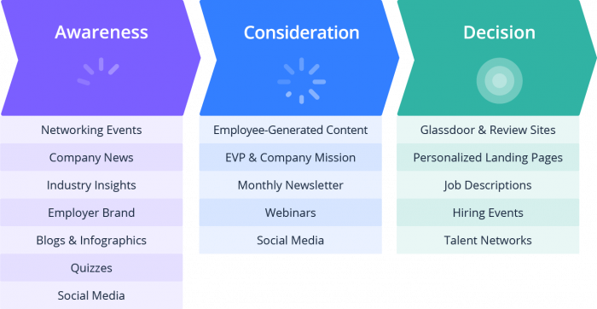
Curate Your Talent
Talent Review
Succession Planning
Career Pathing
Development Plans
Internships
Apprenticeships
Job Shadows
Youth Events

Slide 17
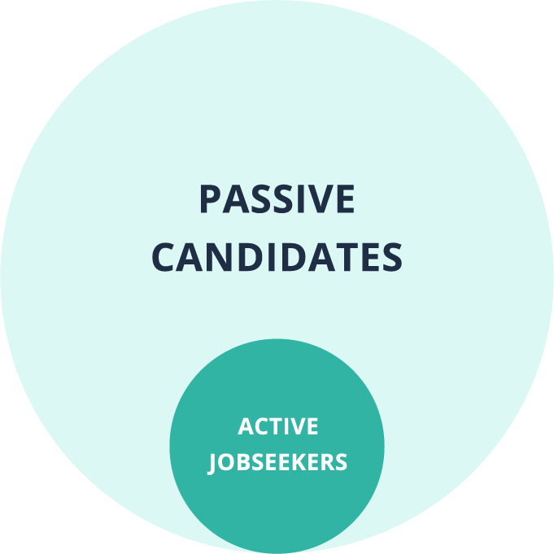
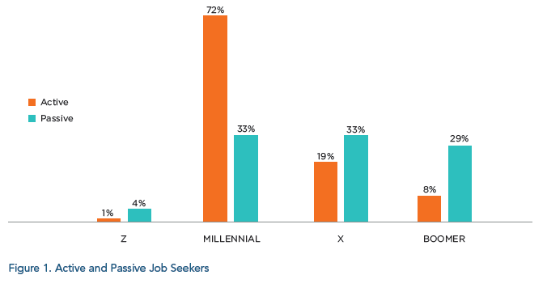
Candidates of Today

Slide 18
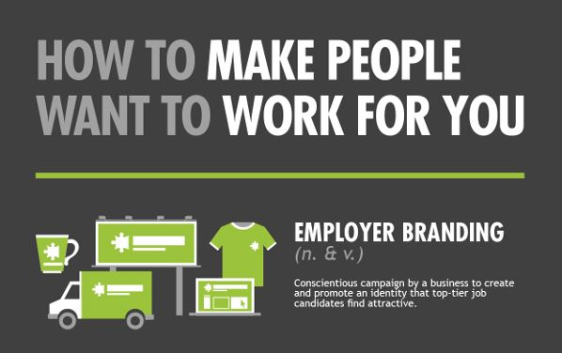

Culture and
Employment Branding

Slide 19

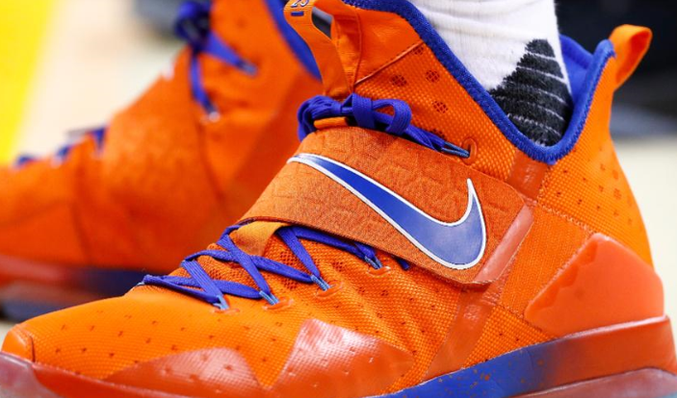
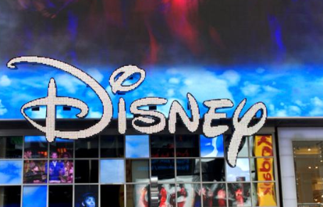

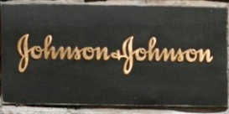

Forbes 2017 Top Brands

Slide 20
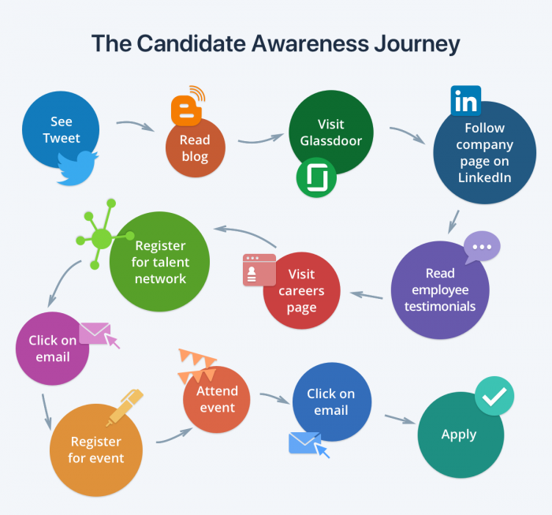

Slide 21

Defining Our Differentiated Value

Slide 22
Forbes: 5 Ways to Build Your Brand
Market Everything You Offer
Build A Strong Company Culture
Publicize Your Culture
Provide Culture To Build the Brand
Share What Makes Your Company Unique

Slide 23
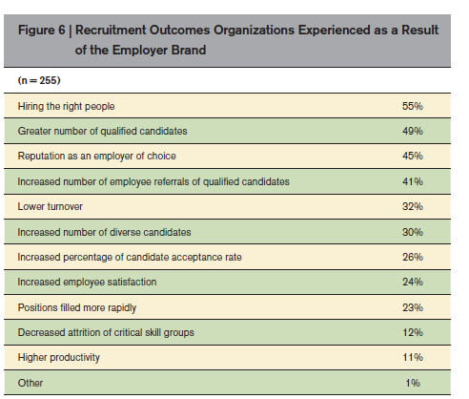
Here’s what you can get…!

Slide 24
Park’s Results
2018 FYTD
Projected Turnover: 9.97% (vs 2018 MA All Industries, 19.4%)
Referral Rate: 59%
New Hire Retention: 93%
Internal Growth: 18%

Slide 25
Questions?

Slide 26


